Slide 1
🚗 Car Sales Analysis Dashboard
This report details the development of a dynamic Power BI Dashboard for a car dealership, offering real-time insights into sales performance, customer preferences, and dealer efficiency across regions.
Project Background & Objective
Project Background
Objective
The dealership sought to understand sales, customer preferences, and dealer efficiency. The dashboard provides real-time insights for stakeholders to assess performance, compare years, identify top brands/colors/body styles, analyze regional performance, and monitor weekly trends.
To design a comprehensive Power BI Dashboard that tracks key KPIs (YTD, MTD, YOY, PYTD), shows weekly, company-wise, and region-wise trends, visualizes product preferences, and provides a detailed data grid for deeper analysis.
Data Preparation & Modeling
Data Cleaning
Date Table Creation
Data Modeling
Performed in Power Query: verified date formats, removed duplicates, ensured correct numeric and text field typing, and created a star schema.
A dedicated Calendar table was created with Year, Month, Quarter, and Week Number columns, marked as a Date Table for time intelligence.
Implemented a clean star schema with car_data as the fact table and Calendar as the dimension table, linked by date.

Slide 2
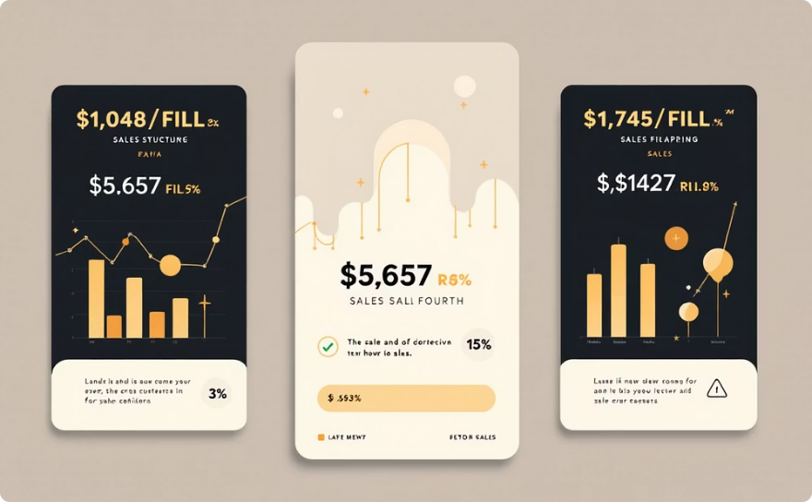
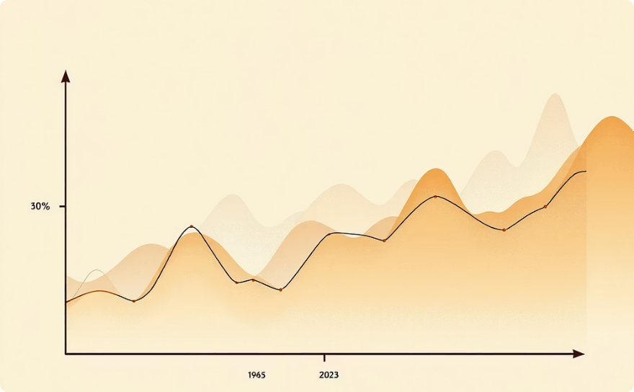
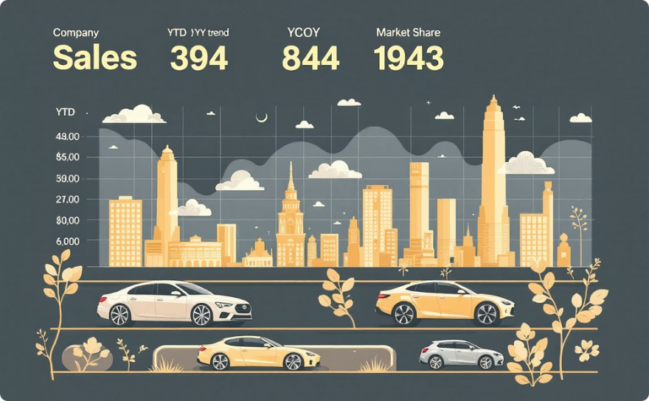
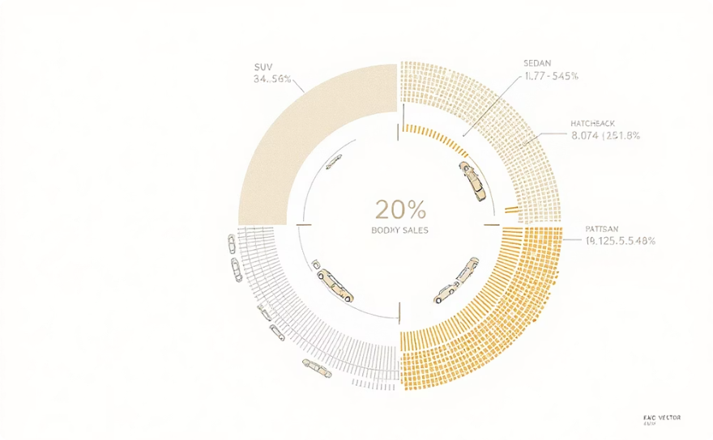
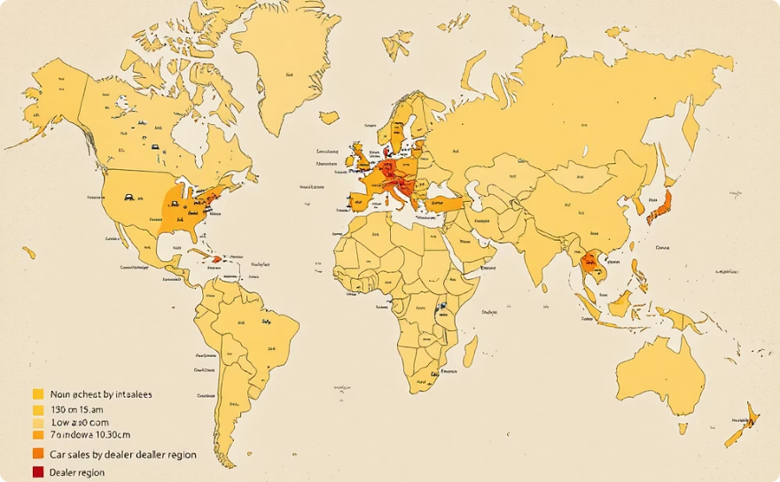
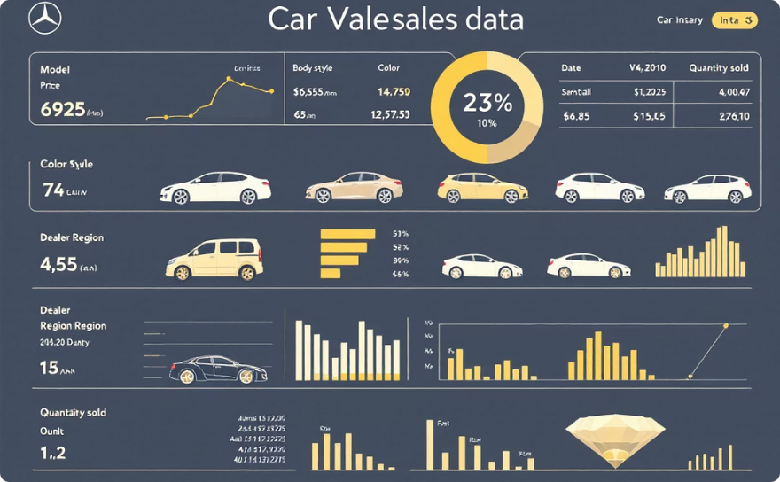
DAX Measures & Dashboard Visuals
Time intelligence was central to the dashboard, with DAX measures created for all key performance indicators.
1
2
3
Total Sales & Time Intelligence
YOY Growth
Average Price & Cars Sold
Calculated Total Sales, YTD Total Sales, MTD Total Sales, and PYTD Total Sales using DAX functions.
YOY Total Sales % was calculated to compare current year performance against the previous year.
Metrics for Avg Price and Cars Sold were developed, with similar YTD, MTD, PYTD, and YOY logic applied.
Dashboard Visuals Created
KPI Cards
YTD Weekly Trend
Company-Wise Sales Grid
Sales by Body Style & Color
Displayed YTD Total Sales, MTD Total Sales, YOY % Sales, YTD Cars Sold, YTD Average Price, and YOY Avg Price with conditional formatting.
A line chart highlighted sales patterns, peaks, seasonal dips, and week-over-week variations.
A tabular grid compared performance across brands, including YTD sales, YOY trend, and market share.
Donut charts visualized product preferences by body style and color, aiding inventory planning.
Sales by Dealer Region
Detailed Sales Table
A geographic map identified high and low-performing regions and the impact of the dealer network.
A comprehensive data grid provided full transparency for deep analysis, including model, price, and quantity sold.

Slide 3

Key Business Insights Identified
The dashboard visuals revealed critical insights into sales performance and customer behavior.
SUV & Sedan Dominance
Regional Outperformance
These segments contribute the highest revenue and units sold, indicating strong market demand.
Western and Southern dealer regions consistently show strong YTD performance.
Popular Colors
Steady YTD Growth
Blue, White, and Black cars are the most sold colors, influencing inventory decisions.
Overall YOY growth is positive, reflecting improved performance.
Company Leaders
Cyclic Weekly Sales
Brands like Ford, Toyota, and BMW exhibit the highest YTD sales.
Sales spike during specific weeks, possibly around weekends or discount periods.

Slide 4

✅ 1. Focus on Best-Selling Body Styles
Insight: SUV and Sedan have the highest YTD sales.
Action Plan
Impact
Increase inventory for SUVs and Sedans.
Higher conversion rates due to strong existing demand.
Launch targeted promotions for these segments.
Offer special financing options.

Slide 5

✅ 2. Optimize Inventory Based on Most Popular Colors
Insight: White, Blue, Black are top-selling colors.
Action Plan
Impact
Stock more units in these popular colors.
Faster inventory turnover and higher customer satisfaction.
Reduce orders of slow-moving colors.
Offer discounts to clear slow-moving colors.

Slide 6
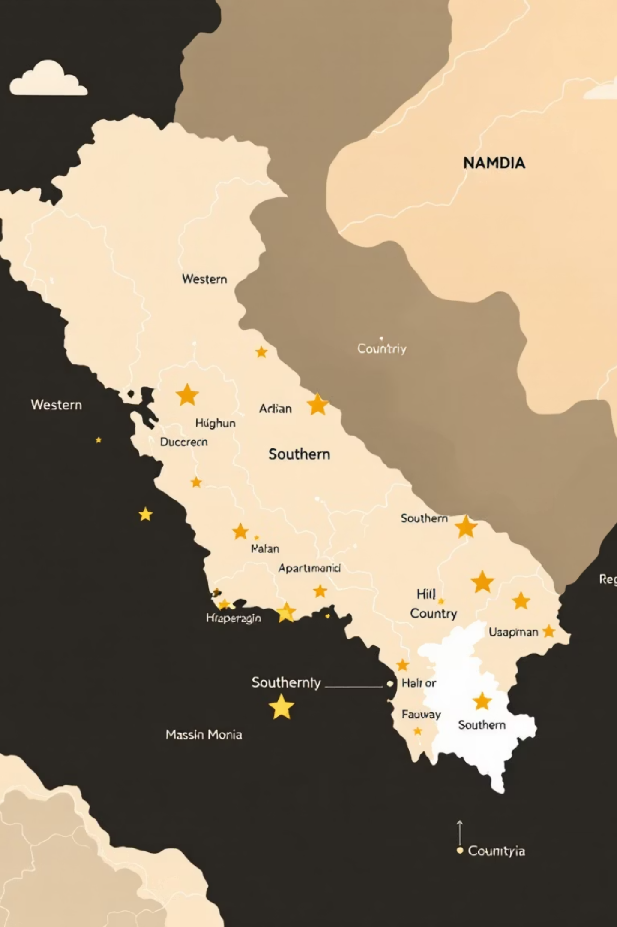
✅ 3. Strengthen High-Performing Regions
Insight: Certain regions (ex: West/South) drive more YTD sales.
Action Plan
Allocate more inventory to high-performing regions.
Increase marketing spend there.
Expand dealer branches in high-demand areas.
Impact
Maximize revenue from regions with proven demand.

Slide 7

✅ 4. Improve Dealer Performance in Weak Regions
Insight: Some regions show weak YTD Cars Sold.
Action Plan
Conduct dealer training (CRM, negotiation, product demo).
Offer incentives for meeting sales targets.
Improve local advertising in low-performing regions.
Impact
Closes the performance gap between regions.

Slide 8

✅ 5. Use Weekly Trend Data for Targeted Promotions
Insight: Weekly trend line shows peaks and dips.
Action Plan
Run promotions during historically slow weeks.
Launch weekend flash sales (if weekend sales spike).
Offer festival/seasonal discounts where spikes occur.
Impact
Smoothens sales fluctuation and boosts overall revenue.

Slide 9
✅ 6. Leverage YOY Analysis for Growth Opportunities
Insight: YOY growth shows improving or declining performance.
Action Plan
Impact
For declining YOY: investigate pricing, competition, dealer activity.
Data-driven decision-making based on real performance.
For growing YOY: double down on successful strategies (models, regions).
✅ 7. Enhance Pricing Strategy
Insight: YTD Average Price and YOY Avg Price show price sensitivity.
Action Plan
Impact
Review pricing for slow-moving models.
Improves profit margin without losing sales volume.
Introduce bundle offers (insurance + accessories).
Adjust pricing by region based on demand.

Slide 10
✅ 8. Push Underperforming Brands with Special Campaigns
Insight: Company-wise grid shows leading and lagging brands.
Action Plan
Impact
Exclusive promotions for underperforming brands.
Balances brand performance and increases dealership revenue.
Collaboration with brand reps for training.
Highlight top models in the showroom.
✅ 9. Use Customer Insights for Better Targeting
Insight: If your dataset contains age group, gender, or city.
Action Plan
Impact
Market SUVs to families.
Increases ad efficiency and conversion.
Promote compact cars to younger customers.
Target ads based on city preferences.

